Slide 1
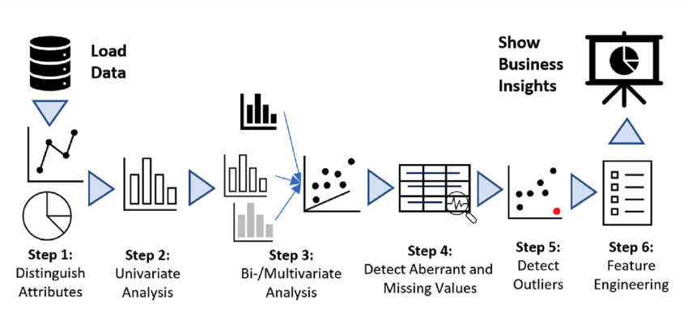

WRONG
RIGHT
APPROACH
TECHNIQUES
IMPUTATION
FEATURE ENGINEERING
FLOW OF APPROACH
WHAT YOU WOULD DO DIFFERENT?
MD ZEESHAN ALI

